Slide 1
Argumentation Mining Project
Machine Learning & Content Analytics
MSc Business Analytics AUEB

Slide 2

The Team and Roles
Nikolaos Gkizelis – f2822003
B.Sc. of Electrical and Computer Engineering
Aristotelis Michailidis – f2822019
B.Sc. of Mathematics
Regarding the team roles, both of them contributed on:
Abstract annotation
Data preparation
Creation and implementation of models
Report composition and interpretation

Slide 3
The Time Plan
14/07
31/08
31/07
18/08
05/09
Abstract Annotation
Data Preparation
Model implementation
Report Composition
Final Submission

Slide 4

The Problem & Mission
Scientists cannot keep pace with the high volume of scientific published articles. Thus, there is a need for an automated text mining tool which will be used for content quality evaluation.
The goal is to implement a text mining tool that annotates evidence-based and claim-based statements in order to guide clinical decision-making with scientific information from systematic reviews.

Slide 5

The Dataset – Arguments
The dataset comprises scientific abstracts linked
with the Sustainable Development Goals of the
United Nations.
2.686 abstracts
32.004 sentences in total
3 Labels (classes)
Neither: 69.9% Evidence: 19.4% Claim: 10.7%

Slide 6

Data Pre-Processing
Lemmatization
Numbers and Punctuations
Stop words removed (NLTK library)

Slide 7
Splitting the Dataset
70:30 ratio
Stratified splitting
TRAIN
30% of the data
9,602 sentences
TEST
70% of the data
22,402 sentences

Slide 8
Intuitive Baseline
LAST SENTENCE IS CLAIM
Assigning the last sentence of each abstract we find out that:
1.550 abstracts out of 2.686 abstracts have their last sentence labelled as Claim
1.550 sentences out of 3.419 Claim sentences of the dataset were labelled as Claim
45% Accuracy

Slide 9
Intuitive Baseline
LEXICON - CLAIM
We create a lexicon with the 25 most common words that exist in
claim-based sentences.
We are interested if can predict the claim-based sentence from test dataset
just by the occurrence of at least one word of the lexicon in the sentence.
 | OTHER | CLAIM
OTHER | 815 | 211
CLAIM | 5197 | 3379
43% Accuracy
79% Recall

Slide 10
Intuitive Baseline
LEXICON - EVIDENCE
We create a lexicon with the 25 most common words that exist in
evidence-based sentences.
We are interested if can predict the evidence-based sentence from test dataset just by the occurrence of at least one word of the lexicon in the sentence.
 | OTHER | EVIDENCE
OTHER | 1392 | 471
EVIDENCE | 3828 | 3911
55% Accuracy
74% Recall

Slide 11
Neural Networks
Pre-Processing our Data (labels to integers, etc.)
Our Y variable was transformed to One-Hot Vectors
Defining our vocabulary with 15,000 words in total
Tokenization (Training Dataset)

Slide 12
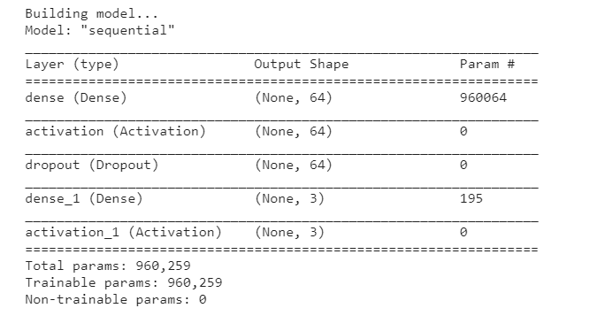

Feed Forward MLP
960,259 Params
Dropout (40%)
Early Stopping

Slide 13
Feed Forward MLP - Results
 | Precision | Recall | F1-score | Support
Neither | 80% | 94% | 86% | 6713
Evidence | 67% | 49% | 57% | 1863
Claim | 63% | 22% | 32% | 1026
77.4% Accuracy
 | NEITHER | EVIDENCE | CLAIM
NEITHER | 6294 | 323 | 96
EVIDENCE | 907 | 920 | 36
CLAIM | 680 | 123 | 223

Slide 14
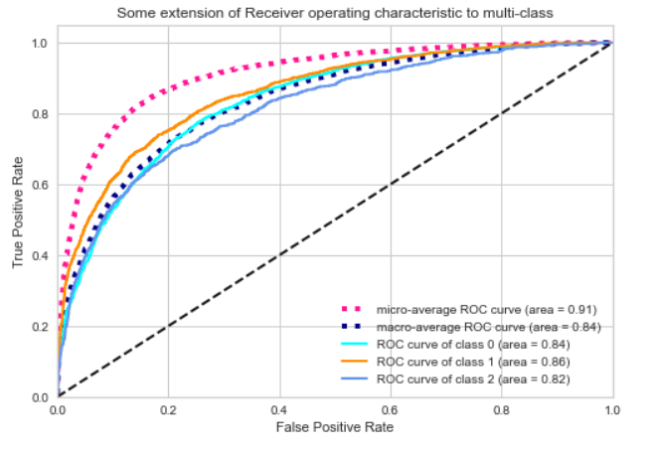
Feed Forward MLP – Results –
ROC Curve

Slide 15
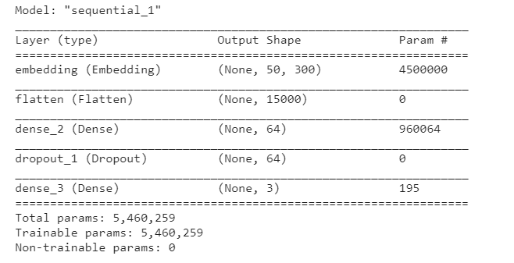
Feed Forward MLP with Embedding Layer
Padding (length=50)
960,259 Params
Dropout (40%)
Early Stopping
(epoch=5)

Slide 16
Feed Forward MLP with Embedding Layer- Results
 | Precision | Recall | F1-score | Support
Neither | 84% | 88% | 86% | 6713
Evidence | 58% | 62% | 60% | 1863
Claim | 58% | 35% | 44% | 1026
77% Accuracy
 | NEITHER | EVIDENCE | CLAIM
NEITHER | 5887 | 635 | 191
EVIDENCE | 641 | 1153 | 69
CLAIM | 482 | 183 | 361

Slide 17
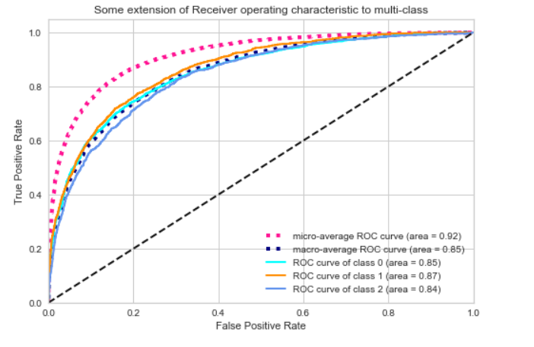
Feed Forward MLP with Embedding Layer- Results

Slide 18
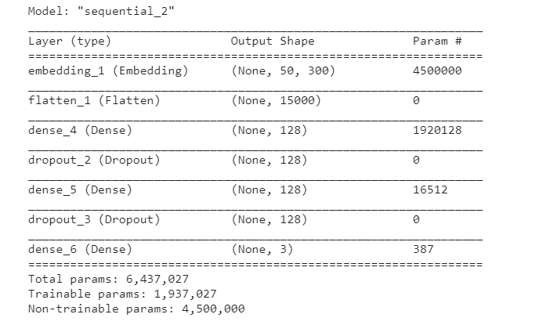
Feed Forward MLP with
Pre-Trained Glove Embeddings
1,937,027 Trainable Params
Dropout (40%)
Early Stopping
(epoch=4)
No overfitting

Slide 19
Feed Forward MLP with Pre-Trained Glove Embeddings- Results
 | Precision | Recall | F1-score | Support
Neither | 70% | 100% | 82% | 6713
Evidence | 0% | 0% | 0% | 1863
Claim | 0% | 0% | 0% | 1026
69.91% Accuracy
 | NEITHER | EVIDENCE | CLAIM
NEITHER | 6713 | 0 | 0
EVIDENCE | 1863 | 0 | 0
CLAIM | 1026 | 0 | 0

Slide 20
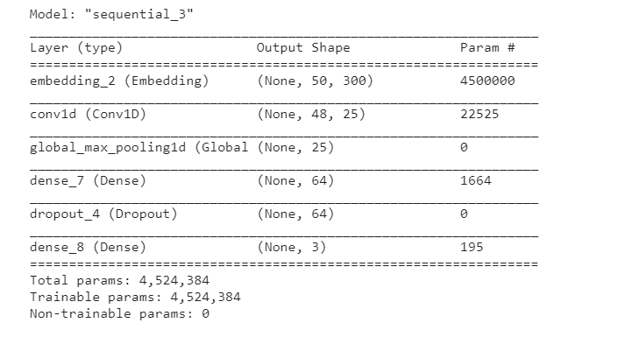
Convolutional (1D) Neural Network (CNN)
4,524,384 Params
Convolution – Max Pooling Layer
Dropout (40%)
Early Stopping
(epoch=6)
Kernel Size = 3 (Trigrams)

Slide 21
Convolutional Neural Network
-Results
 | Precision | Recall | F1-score | Support
Neither | 80% | 92% | 86% | 6713
Evidence | 61% | 54% | 57% | 1863
Claim | 58% | 16% | 25% | 1026
76.5% Accuracy
 | NEITHER | EVIDENCE | CLAIM
NEITHER | 6165 | 462 | 86
EVIDENCE | 819 | 1010 | 34
CLAIM | 680 | 177 | 169

Slide 22
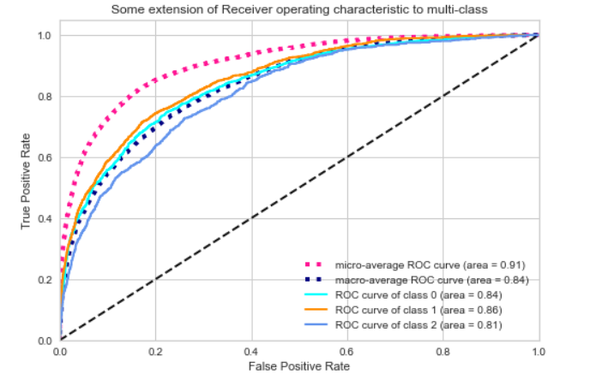
Convolutional Neural Network
-Results

Slide 23
Abstract Clustering (K-means)- Optimal Number of Clusters
Document Embeddings for each Abstract
100-size vectors for each abstract
Word2vec model for extracting word embeddings for abstracts
(32004, 100) shape

Slide 24
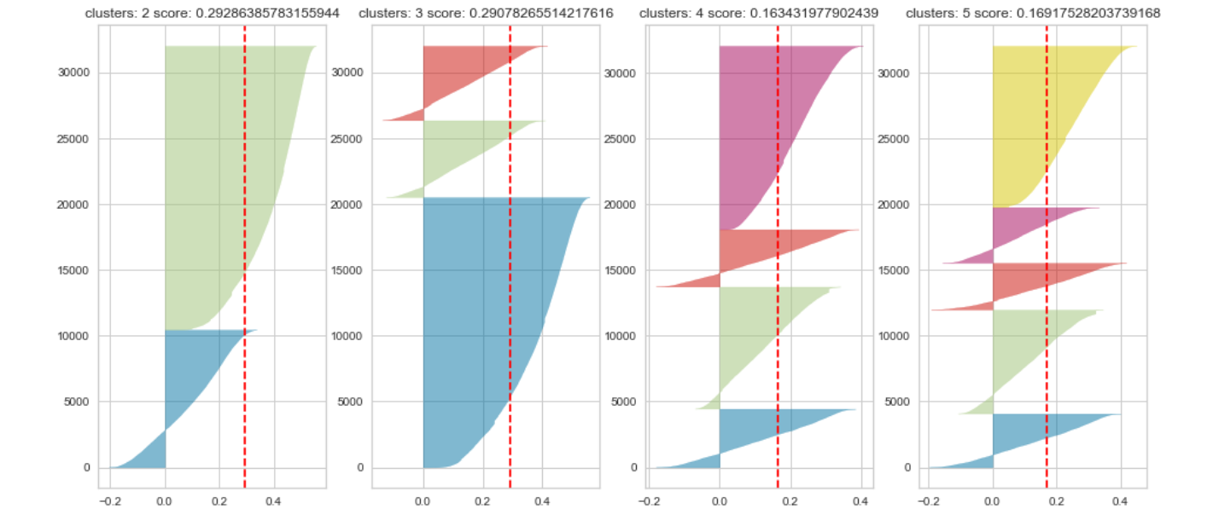
Abstract Clustering (K-means) Results
Based on Silhouette Score finding optimal number of clusters
2 clusters

Slide 25
Conclusion & Comments
MLP with Embedding Layer – Best Model (Precision – Recall – Accuracy for Claims)
MLP with Pre-trained Glove Embeddings – Worst Model
Randomness (data splitting, dropout)
Unbalanced and relatively small dataset

Slide 26
Thank you for your attention!

